Slide 1

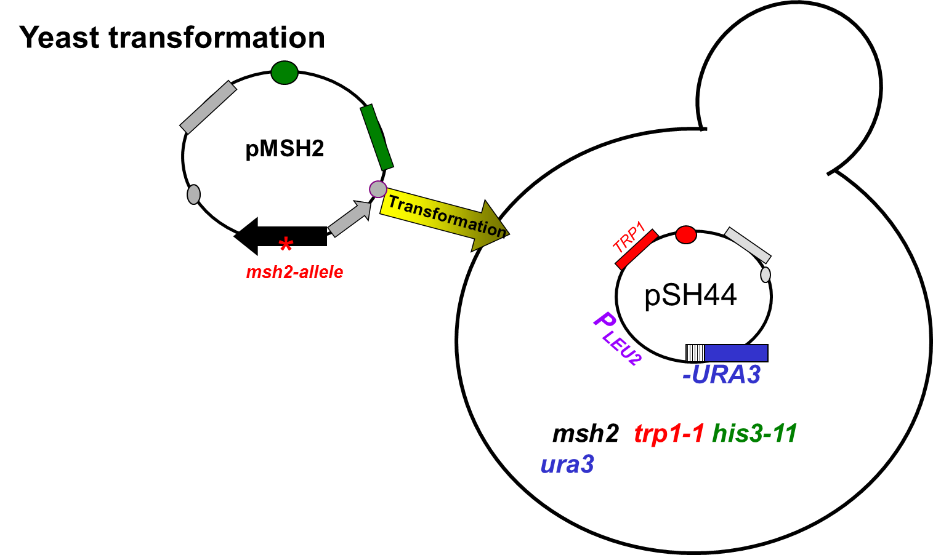
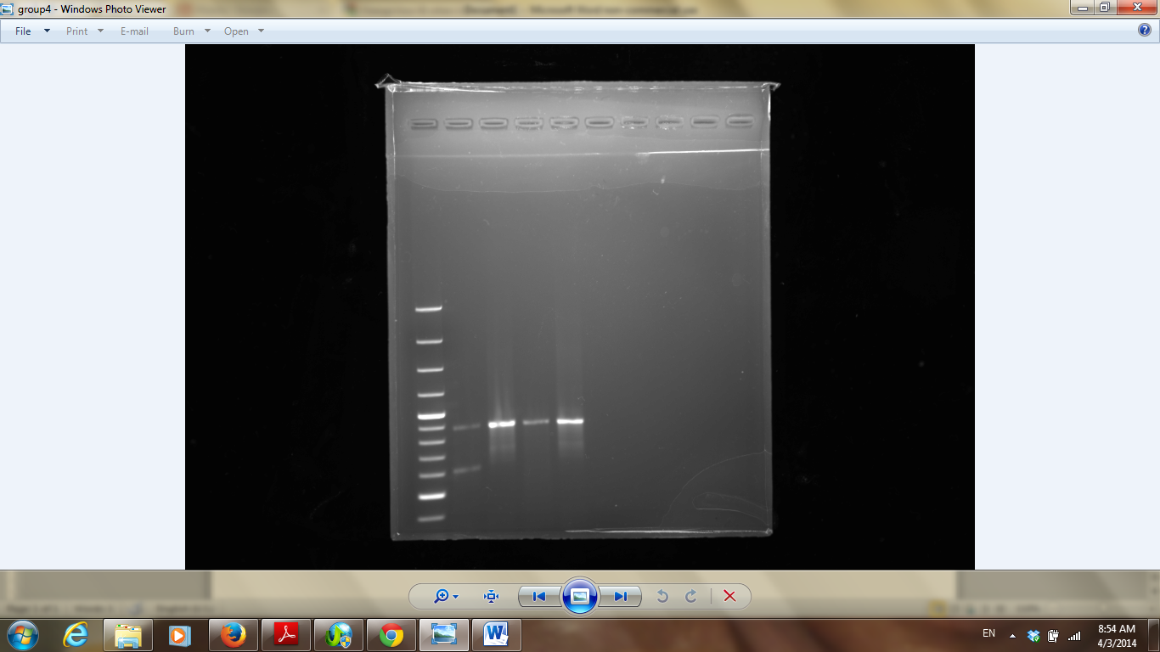
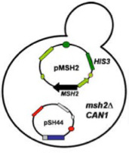
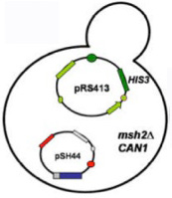
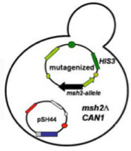
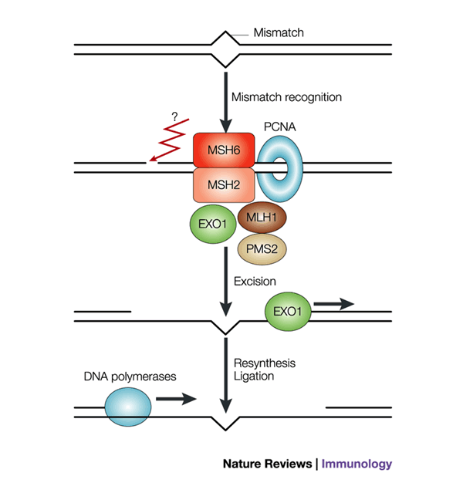
Understanding Hereditary Nonpolyposis Colon Cancer through Functional assay of Human MSH2 Missense Mutations in Yeast
^{Meigan Bryant,} ^{Tonia Iwule}
^{Advisor: Dr. Hong Qin}
Department of Biology, Spelman College, Atlanta, GA 30314
Abstract
Materials and Methods
Summary and Conclusion
The different band pattern between cut and uncut enzyme shows difference in fragment size. Restriction enzyme digestion was successful. (Figure 1)
HIS3-
The difference in band pattern between mutant and wild type MSH2 suggests primer mutagenesis was also successful. (Figure 1)
In the complementation assay with 5-FOA we anticipated to see growth identified by formation of colonies in the sections containing yeast transformed with the empty vector, while there should be no growth on the section of the plate spotted with yeast transformed with the wild type MSH2 gene. That is because functional MSH2gene would repair the MMR function allowing for expression of URA3 gene in the pSH44. Functional URA3 enzyme would metabolize 5-FOA to the toxic 5- fluorouracil which would kill the yeast cells and prevent formation of colonies. If mutant MSH2 allele is able to restore the function of MMR system we would not see yeast colonies. Since there are yeast cells visible in the wild type, mutant, and vector potions of the 5-FOA plate there is a strong possibility that the strains were mislabeled . (Figure 2)
Results
PCR analysis
Size Ladder mutant WT cut Mutant WT V.cut V.Uncut
cut uncut uncut
Introduction
Colorectal cancer is very common cancer and known for the second leading cause of death in the United States. The cancer was diagnosed in about 153,000 Americans in 2006 and resulted in 56,000 deaths. In further exploration 2-7% of the results showed that the cancer was inherited or had an inherited form of the disease (hereditary nonpolyposis colorectal cancer). Colorectal cancer accumulates when tumors are formed in the large intestines, colon and rectum. This cancer is associated with defects in DNA mismatch repair. DNA mismatch repair contributes to the preservation of genetic material. One of the main mismatch repair system genes is MSH2, which is highly conserved in both prokaryotes and eukaryotes. Approximately 30-31 percent of all cases of hereditary nonpolyposis cancer are results of mutations in this gene. In prokaryotes, DNA mismatch repair begins with identification of mispaired bases in the DNA helix. MutS acts as a homodimer to bind to mispaired DNA. After recognition, the MutL homodimer complexes with MutS and initiates other repair events including displacement and excision of the error containing strand. Without an intact mismatch repair system, numerous mutations can accumulate, some of which eventually lead to cancer such as hereditary nonpolyposis colorectal cancer. In this experiment, strains of Saccharomyces cervisiae, budding yeast was used because it is possible to test for MSH2 function and the similarity of its mismatch repair system to humans.
In subsequent experiments we will evaluate the MSH2 protein levels isolated from the wild type MSH2 transfected yeast to determine whether the mutation in the MSH2 affects expression of the gene.
Discussion
Enzyme restriction analysis revealed differences in band pattern between the wild type and the MSH2 gene indicating that the primer directed mutagenesis was successful and the mutation is present in the mutant MSH2 gene. The transformation of the yeast with pSH44 plasmid and with plasmids containing MSH2 alleles was successful as indicated by the growth of yeast colonies on the selective SD-his-trp plates. In the 5-FOA complementation assay major growth was observed in the wild type and the least amount of growth was observed in the vector. This was the opposite of what we expected to occur, so we have attributed this to a labeling error in our samples.
Yeast can be used to evaluate DNA mutations in human MSH2gene, and suggest preventive treatment.
MSH2
Experimental Objective
Vector
References
Gammie, A. E., and N. Erdeniz. “Characterization of Pathogenic Human MSH2 Missense Mutations Using Yeast as a Model System: A Laboratory course in Molecular Biology.” Cell Biology Education 3.1 (2004): 31-48. Print
Gammie, A. E., and N. Erdeniz. “Functional Characterization of Pathogenic Human MSH2 Missense Mutations in Saccharomyces Cerevisiae.” Genetics 177.2 (2007): 707-21. Print.
H658Y
Acknowledgements
Dr. Hong Qin, Dr. Dongfang Wang, and Dr. Stephen Kioko for helping us in the laboratory this semester.

